Slide 1
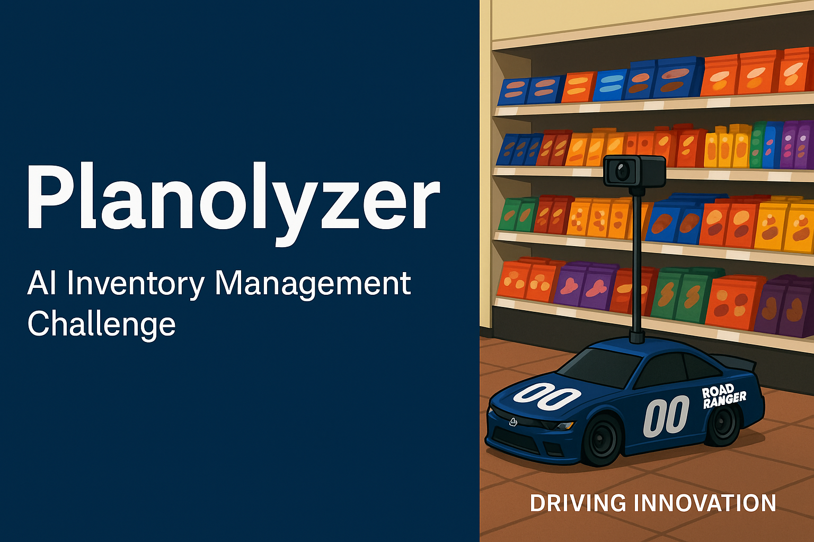

Slide 2
The Problem We're Solving
Retailers lose millions due to out-of-stocks and poor planogram compliance.
Audits are slow, expensive, and often miss key issues.
Employees lack time and tools to detect shelf problems in real time.
Notes:
[1.5 min] Retailers face consistent revenue loss from empty shelves and misplaced items. Manual audits are inefficient, and store teams don’t have time for constant checks. Customers leave when they can’t find what they need—Planolyzer can solve that.

Slide 3
The Vision
Planolyzer: an AI-powered image analysis tool for real-time inventory insights.
Phase 1: Photos taken via phone.
Phase 2: Upgrade to in-store cameras and autonomous scanning bots.
Notes:
[1.5 min] Our vision is simple: help stores manage inventory in real time by analyzing photos taken throughout the day. We start small—with phones—but we’re building toward a smarter store equipped with live scanning systems.

Slide 4
How It Works
Reference planograms and layout data are loaded into the system.
AI analyzes incoming shelf images to identify zones and compare expected vs actual.
Alerts sent for out-of-stock or misplaced items.
Notes:
[1.5 min] Here’s how the system works. First, we load planogram images and definitions into the AI. Then we match incoming shelf images with those reference layouts, flagging missing or misplaced items.

Slide 5
MVP Features (7-Day Challenge)
Planogram Reference Builder: Link planogram images with tabular definitions.
Section Classifier: Identify shelf zones from input images.
Out-of-Stock Detector: Flag missing or misplaced products.
Simple report/dashboard preview.
Notes:
[1.5 min] In the next 7 days, we’re building the MVP. It will include a planogram builder, image classifier, and an out-of-stock detector. We’ll also generate simple visual reports to preview the results.

Slide 6
Technical Stack [ALL PLACEHOLDERS]
CV/ML: OpenCV, YOLOv8, Detectron2, Grounding DINO (TBD).
Backend: Python + FastAPI with SQLite or cloud DB.
Frontend: Streamlit or lightweight React dashboard.
Cloud Option: AWS S3 or Azure Blob for image storage.
Notes:
[1.5 min] On the tech side, we’ll use OpenCV and YOLO or Detectron2 for object recognition. FastAPI will serve the backend, and we’ll keep the frontend simple—perhaps Streamlit. Images can be stored in Azure or AWS.

Slide 7
Real Impact for Stores
Faster response to inventory issues = fewer lost sales.
Managers can quickly audit shelves without walking the floor.
Lays foundation for future automation and robotics.
Notes:
[1.5 min] Planolyzer offers huge value: less time spent walking aisles, fewer stockouts, and better shelf integrity. This helps staff focus on service, not shelf scanning.

Slide 8
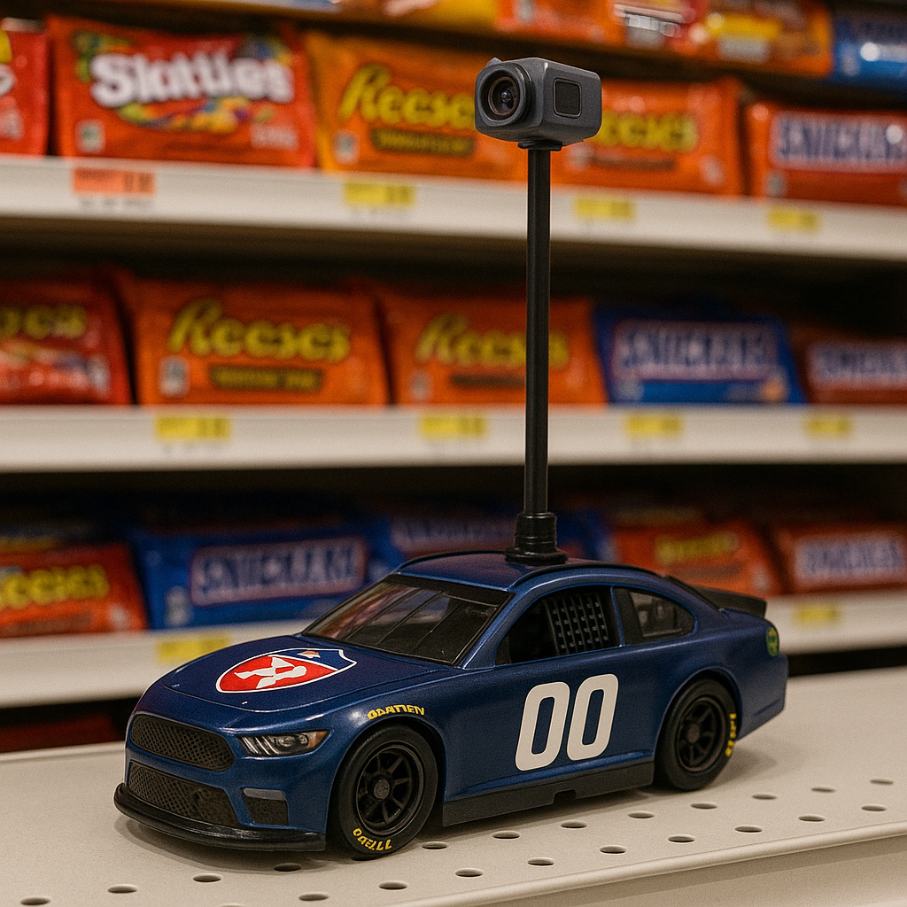
Stretch Goals
Enable mobile app photo submission and instant feedback.
Voice queries: 'Where are the Oreos?'
Start designing a scanning bot (toy-scale proof of concept).
Notes:
[1.5 min] Stretch goals include voice queries and mobile photo submission, customer loyalty OOS bounty. We’re also prototyping a toy-size autonomous bot inspired by NASCAR—our Road Ranger Planolyzer!

Slide 9
Driving Innovation
Future integrations with autonomous bots.
Enabling always-on retail intelligenceehe
Step-by-step roadmap to evolve from MVP to full deployment.
Notes:
[1.5 min] This is just the beginning. With store cameras and autonomous bots, we’ll bring always-on intelligence to every aisle. Planolyzer is driving innovation into the future of retail.

